Slide 1

MEDIATOR DESIGN PATTERN
how to simplify your code and handle cross-cutting concerns using mediatr library

Slide 2

Code and extra materials
https://github.com/vesou/MediatRDemo
https://github.com/jbogard/MediatR/wiki
Code Opinion YT - https://www.youtube.com/watch?v=ngeEYUy9hI8
Jonathan Williams YT - https://www.youtube.com/watch?v=mdzEKGlH0_Q
Nick Chapsas YT - https://www.youtube.com/watch?v=2JzQuIvxIqk
Notes:
- strongly suggest to follow some of those YouTube channels as it's a really good place to get the latest info from

Slide 3
Agenda
problems with a standard way of building WebApi in .NET
.NET framework way of fixing big and clunky Controllers approach
introduction to Mediator design pattern
handling cross-cutting concerns
speed and memory concerns
Extra – “outOfProcess” solution – leveraging “Hangfire” library

Slide 4
What this presentation is not about
Command and Query Responsibility Segregation (CQRS)
Vertical Slices Architecture
MediatR supports 3 different messaging strategies
Pub/sub approach – .Publish()
Streaming of IAsyncEnumerable - .CreateStream()
Notes:
- CQRS - mediator supports it by convention (Query and Command being added into the Request Names) and even encourages it but does not enforce it
- Vertical Slices – similarly it is fully supported
- Pub/Sub – done in processes so probably shouldn’t be used for EventMessaging between services so maybe just for Internal Events
- Streaming – really good but not part of this talk

Slide 5
So what is it about?
One-to-one mapping - .Send()
Notes:
A simple one to one mapping between request-handler-response

Slide 6
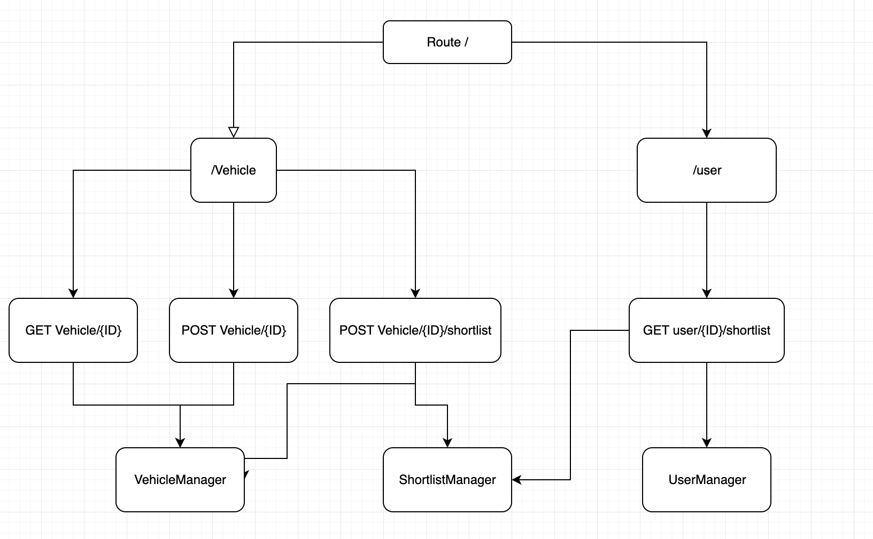
Standard approach
Domain Driven Design dictates how well this approach will work over the coming months of developing new solution
Notes:
- depending on how good you are designing your domain objects sometimes this may lead to a single controller that has to have access to multiple repositories, services or managers
- it’s a big file of mostly unrelated methods – most of them don’t need to know about the dependencies of other methods

Slide 7
Problems with standard approach
Extending functionality – Open/Close Principle
Interface Segregation Principle
Single Responsibility Principle
Notes:
- open/close principle – adding new route may force you to add a new dependency or maybe even add a new strategy that will require you to change other endpoint to continue on working
- Interface Segregation Principle – even though there is no interface on this you can see how it forces you into bundling together multiple unrelated methods
- single responsibility? – manage HTTP Context for a particular root route

Slide 8
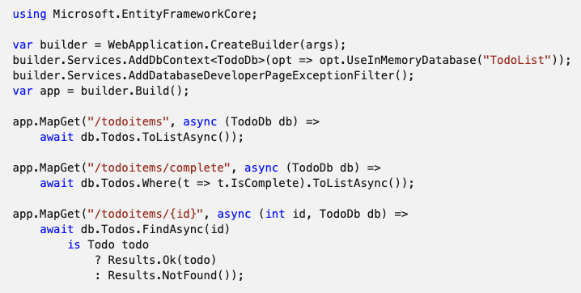
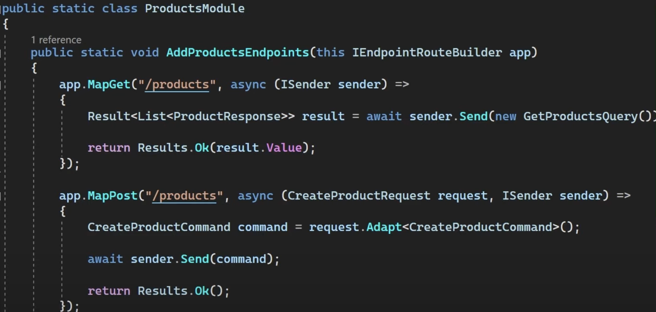
Current framework solution
Minimal api’s
File per route / endpoint approach
Single file approach
Notes:
- Minimal API's
- single file - not suitable for any larger developments - good for POC or prototyping
- multiple files with extension methods - better but has it's own limitations
-- needs to create many extension methods
-- or reflection

Slide 9
Solution…

Slide 10
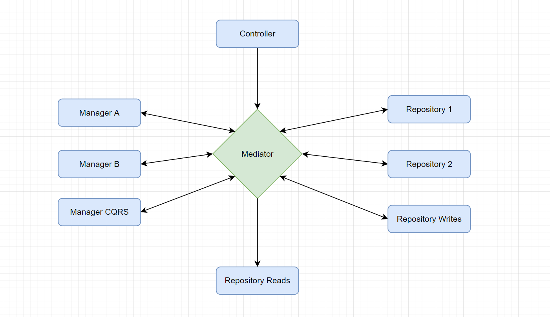
Mediator design pattern
Notes:
- kind of a big dictionary that maps the request to a selected handler

Slide 11
Simple mediator implementation
Let’s jump into the code
Notes:
replace service/manager logic with a specific Handler
drawbacks
more files
finding correct handler from the caller (controller) - discoverability
fixing the problem with finding handler - refactor request into the same file
benefits
only required service registrations
much smaller file focused on a single behaviour/action

Slide 12
Implementing Cross-cutting concerns
the real game changer – pipeline behaviours
Notes:
- did you ever had to add a common functionality between a set of endpoints?
- .net middlewares
- or decorator design pattern
- logging, gathering metrics, validation, cacheing?

Slide 13
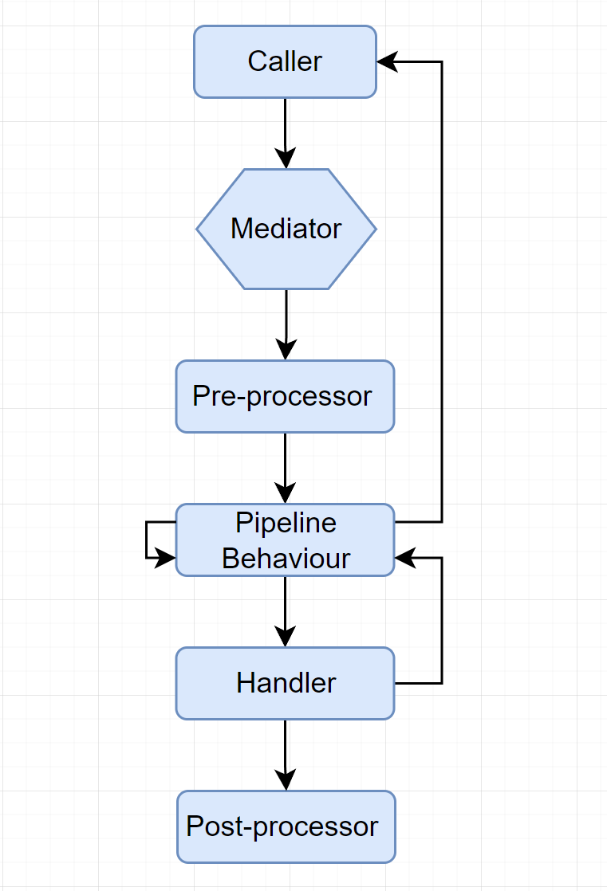

Slide 14
Speed and memory concerns
Is it really that slow?
Video to watch for those interested in more stats https://www.youtube.com/watch?v=baiH3f_TFfY
Notes:
- the speed impact is negligible in most of the cases when looking at a real world API
- the higher memory consumption is more impactful in a highly memory restricted scenario as it causes more often GC
– like inside a Kubernetes pod, but still negligible in my opinion

Slide 15
Implementing Out of process solution
Using hangfire to run tasks outside of http context
Notes:
- did you ever had to add a common functionality between a set of endpoints?
- .net middlewares
- or decorator design pattern
- logging, gathering metrics, validation, cacheing?

Slide 16
Q&A

